Slide 1

Notes:
[BRIEF WORD ABOUT VIDEO CLIP]
We begin a new Lent to Easter sermon series today called, Wandering Heart: Figuring out faith with Peter. In this series, we’re going to follow Peter’s journey with Jesus. We will be encouraged but also challenged as we prepare our hearts for Easter Sunday. Like many of us, Peter has a wandering heart. His journey is not polished, or linear, or perfect, but he is always tethered to the love of God. When you look closely at Peter’s story, you find Jesus at each step along the way—offering him abundance, catching him when he begins to sink, challenging him when he stands in the way, washing his feet, predicting his betrayal, and offering him agapē love.
When you consider Peter’s story, the lyrics of the hymn “Come Thou Fount of Every Blessing” come to mind. And so, for each step in Peter’s journey, we’re going to reflect on the life of Peter and sing that hymn, binding our own wandering hearts to God.
Here is where we’re going each week… [NEXT SLIDE]

Slide 2

Notes:
Notice that the icons correspond to a significant moment in Peter’s journey. Today we begin with Simon Peter’s first encounter with Jesus and his calling to be a disciple—to be a fisher of people; and we will continue each week with an episode in Peter’s faith journey that aligns with phrases in the hymn. For the first six weeks (leading up to Palm Sunday) we will be in Lent. And then in Holy Week we will continue with our focus in the Maundy Thursday gathering and the Good Friday service. As you can see, this series goes through the first Sunday of Easter. I hope you can join us.
If you’re taking notes, this first message is entitled… [NEXT SLIDE]

Slide 3
Notes:
Jesus Sought Me.
[BRIEF PRAYER]
Please open your Bibles to our main Scripture reading… [NEXT SLIDE]

Slide 4

Notes:
Luke 5:1-11. [INVITE CONGREGATION TO STAND FOR READING]
Last week we concluded the Sermon on the Mount series. And in that final message, I mentioned John Mark Comer’s excellent new book, Practicing the Way. At the beginning of the book, Comer talks about how Jesus’ way of choosing disciples stands in start contrast to the typical rabbinical practice of the first-century.
In Jesus’ day, Jewish boys were trained in Torah from a young age, but only the most exceptional students advanced beyond a primary level of education. And it was only the best of the best who were invited to become a rabbi’s disciple. As disciples, they didn’t just learn information—they sought to: memorize the rabbi’s teaching; imitate the rabbi’s life; and become like the rabbi in every way. And if you weren’t good enough, you simply returned home and took up the family trade. Therefore, discipleship in that world was selective, merit-based, and elite.
So… with that in mind… now think back to what we read about Jesus choosing Peter in Luke 5. And consider a few key contrasts which Comer points out about the way of Jesus… [NEXT SLIDE]

Slide 5

Notes:
[READ SLIDE & COMMENT ON EACH POINT]
So, what does this all mean? What can we conclude from the Jesus way? Friends, it means that you don’t have to be a “spiritual elite” to follow Christ. Apprenticeship to Jesus is open to anyone willing to reorder their life around him. The question isn’t: “Am I qualified?” But: “Am I willing?”
Thankfully, Simon Peter was willing… [NEXT SLIDE]

Slide 6
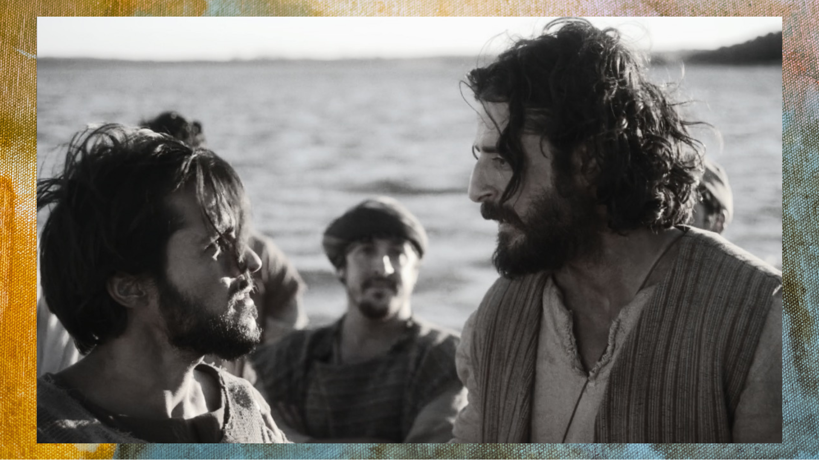
Notes:
We read that Jesus asks to borrow Simon Peter’s boat: no doubt a preview of Peter giving his time, talent, and treasure (his stuff)​ for the Lord’s purposes. And after teaching, Jesus wants Peter to go back out and cast his nets in deeper waters, despite having fished all night and catching nothing. But Simon Peter knows better. Afterall, he is the professional fisherman, not Jesus.
And so, to Peter, it doesn’t make a lot of sense to do what Jesus is asking of him. Ever been there? Has Jesus ever asked you to do something that didn’t make much sense at first? But Peter does what Jesus asks and has the biggest catch of his life. And after the miracle with the fish, Simon isn’t just amazed; he is humbled and brought low because of the holiness and power of Jesus​. And he is so overwhelmed by the grace of Jesus that he gives up his livelihood to follow him.
​
This really is a dramatic turn of events. Up to this point, fishing was everything to Simon Peter and his family. It’s all he knew. Think about it… [NEXT SLIDE]

Slide 7
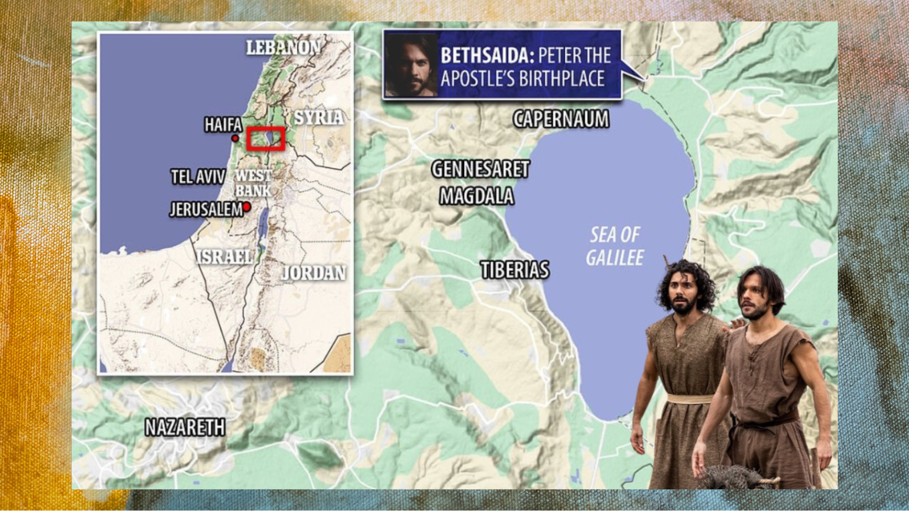
Notes:
[BRIEF COMMENTS]​
He was born in Bethsaida, north side of the Sea of Galilee​
The Galilee was mostly rural—seen as less educated, lower income, less devout, etc.​
We’re told in the Gospels that Simon lives in Capernaum—a fishing village; Jesus makes it his hub​
Simon and Andrew are leaving everything they know (family business, their livelihood, etc.)​
And we know that Simon was married; imagine that conversation!​
​
How do we know he was married? Well, because the previous chapter says that Jesus had healed Peter’s mother-in-law in Peter’s house. Take a look at this… [NEXT SLIDE]

Slide 8

Notes:
[BRIEF COMMENTS ON PICTURES]
Pics of the ruins believed to be Peter’s house; evidence suggests it’s true
A modern church was built over the top of it
So, in Luke 4:38-39, right before our Scripture focus for today, Jesus goes into Peter’s house and healed Peter’s mother-in-law of a fever that had put her near death. Now think about this… what affect did that miracle have on Peter’s faith? Well, maybe he wasn’t too happy about that healing.
We’re not entirely sure how it impacted Peter’s faith. And it’s worth pointing out that Mark and Luke tell it a bit differently. Mark has the miracle coming after, not before. So, what do we make of this? Well, chronology wasn’t as important to the gospel writers as it is to us today. Mark places the healing after the call to highlight Jesus’ authority in action (i.e., accept the call and watch what Jesus can do!), while Luke places the call after a display of grace to show that discipleship begins with a transforming encounter with God’s grace—not because one is more chronological, but because each is making a distinct theological point. The event happened and both are true.
And so, after this encounter with the saving, miraculous power of a loving God, Peter comes to the end of himself and surrenders. And what does Jesus say to Peter then? [NEXT SLIDE]

Slide 9
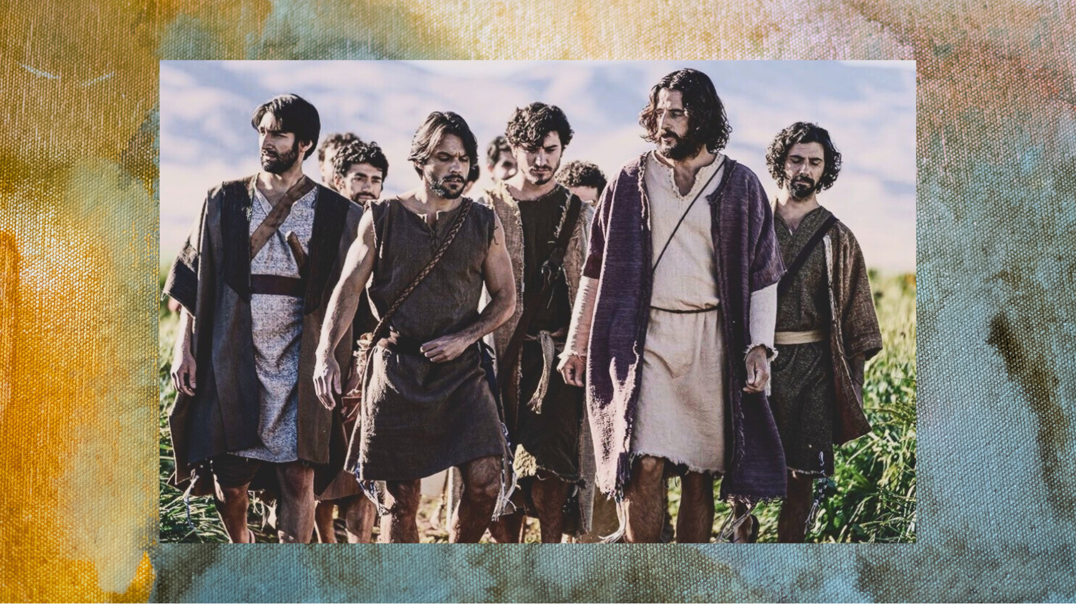
Notes:
He says, in Luke 5, verse 10, I’m calling you to leave your nets so we can go fishing for people. “Leave the nets” – sort of like that saying “burn the ships”— meaning, we’re not going back, but also to indicate that Peter is being offered a new identity and calling–-a new vocation.
This metaphor “fishing for people” speaks of drawing people into the dragnet of the Kingdom; bringing and leading people to the God who looks like Jesus, catching people up in salvation; leading them to a new way of being and living in the Kingdom that is coming. And notice in the last verse, verse 11, Peter doesn’t even seem to hesitate when Rabbi Jesus calls him. Could it be that he is so overwhelmed by the grace and the power of God in his life that this is the natural result and response? And yet, we might wonder: (1) how will Peter now pay his bills and taxes? and (2) Does this mean everyone should quit their jobs? No, but this is Peter’s calling.
Peter—this rural, rough-around-the edges fisherman; barely scraping by to make ends meet, oppressed by the taxes of Rome, and maybe he had even done some shady things for his business to stay afloat (no pun intended). Here is Simon Peter, a man who had already long resigned himself to the fact that he didn’t have what it takes to be a disciple… thinking in that moment… “Rabbi Jesus is calling me?” It reminds me of the words of Paul in… [NEXT SLIDE]

Slide 10

Notes:
[READ PASSAGE & COMMENT]
Brothers and sisters, don’t miss this… Jesus chooses the…
Foolish in the eyes of the world to shame those who think they know stuff
Powerless to expose those who rule over others
Despised and discarded to show the world what God values; and to undo the world’s hierarchy of what is believed to be important, valuable, and worthy of our time and attention.
That means this: If you feel unqualified to follow Jesus, you are exactly the kind of person Jesus calls. The invitation to discipleship is not based on intelligence, your résumé, or moral perfection; it’s based on availability, desire, and surrender to Rabbi Jesus. Amen?
Let’s sum up this message with a few main takeaways… [NEXT SLIDE]

Slide 11

Notes:
Takeaways

Slide 12

Notes:
[READ & BRIEF COMMENT ON EACH TAKEAWAY]
1. Encountering Jesus means experiencing God’s holiness and power.
Following Jesus begins with awe, humility, and honest self-awareness.
Remember what Simon Peter said, ““Go away from me, Lord; I am a sinful man!”
You might recall here the words of the prophet Isaiah when he is surprised by the glory and holiness of the Lord while worshipping in the temple… [NEXT SLIDE]

Slide 13
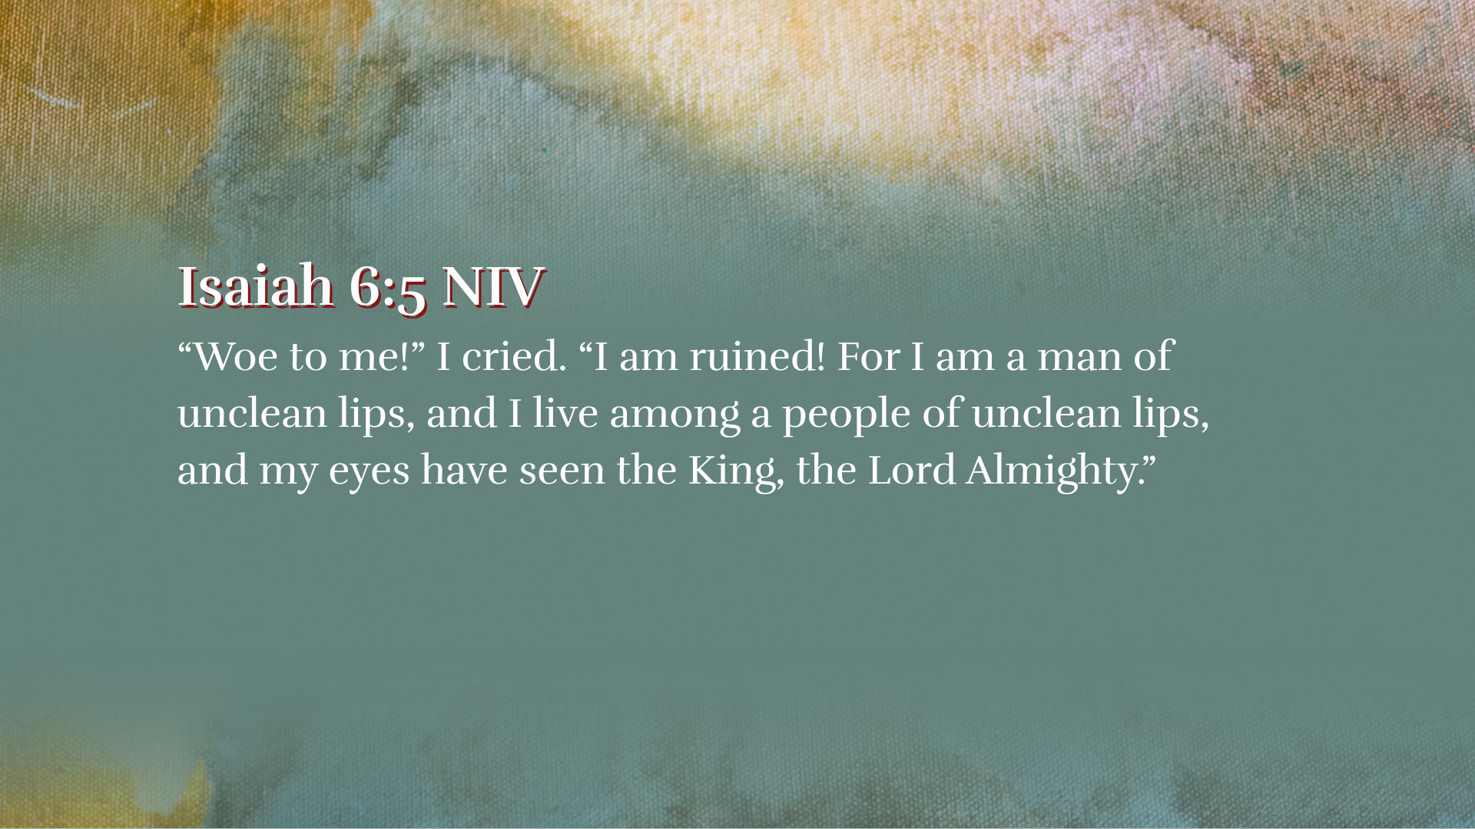
Notes:
[READ VERSE & COMMENT]
Isaiah experiences God’s holy presence and is then called into service
This also reminds me of several stories I’ve read about where people have died, their soul went to heaven, and they experienced the weight of God’s holiness before returning to their body. They said that in the presence of Jesus, every thought, action, and motive was exposed. As you might imagine, that often produced a deep remorse; a sense of “I’m not worthy”; sometimes even shame or grief over sin. That makes sense. And this is very similar to Peter. It wasn’t just the miracle with the fish; it was about suddenly seeing himself as he really is in the light of Christ.
Why is that? Because, folks, when people encounter the real Jesus, they don’t feel impressive, they don’t say, “Oh, I’m just fine the way I am” or feel warm fuzzy feelings—no… they feel exposed, humbled, and in need of grace. But… but… they quickly realize that Jesus, even in his sinless perfection, doesn’t condemn us; instead, he loves us. And they discover what Peter learned that day on the seashore: Jesus does not withdraw from sinners—he invites them to follow him.
Takeaway #2… [NEXT SLIDE]

Slide 14

Notes:
[READ & COMMENT]
2. Grace comes before our calling and being commissioned by Jesus.
We follow and serve Christ in response to his love, mercy, grace, etc.
As I’ve said recently, our good works isn’t generated by a sense of duty or obligation, or a sense of fear, or a desire to earn God’s favor. No, our desire to follow and serve Christ ought to flow naturally from an experience of his love, mercy, forgiveness, and grace in our lives. That is why we’re not in the business of guilt and shame to motive people; those are tools of the enemy. Rather, we rely upon the grace of God to fuel our work. Grace comes before our calling and commission.
And lastly, takeaway #3… [NEXT SLIDE]

Slide 15

Notes:
[READ & COMMENT]
3. Following Jesus means a new identity, calling, and purpose.
Jesus pursues us and invites us to reorient our lives around him.
What is his calling and purpose for your life? Are you living into it?
Finally, instead of several reflection questions at the end of every message in this series, we’re going to be giving you one “response question” on the screen and in your bulletin each week.
And here is the response question for today… [NEXT SLIDE]

Slide 16

Notes:
Ask yourself… “When has Jesus sought me out?”
You may want to go back to the beginning. Think… where did your journey with Jesus begin? How did he first come to you? And how do you sense Jesus seeking you out now?
[CLOSING WORDS & PRAYER]
[GO TO NEXT SLIDE FOR CLOSING PRAYER]

Slide 17

Notes:
CLOSING SONG & ANNOUNCEMENTS
Youth Camp Spudtacular – raising money for summer camps
Benediction
Beloved wanderer, as you leave this place,
may you carry your curious heart on your sleeve.
May you look for God in every face.
May you find the courage to get out of the boat,
to run to the tomb, and to speak of your faith.
And when the world falls apart,
may you hear God’s voice deep within,
saying, “Take heart, it is I, be not afraid.”
You are called. You are blessed.
In both your ups and your downs,
you always belong to God.
Go now in peace.
Go trusting that good news.
Amen.

